Slide 1

Classification of Highly Interacting Regions of the Genome with Explainable AI
Shreya Pawaskar - 4947
Radhika Sethi - 4456
Aanchal Tulsiani - 4964
External Guide: Dr. Leelavati Narlikar
Internal Guide: Mrs. Pranjali Deshpande
Mentor: Miss. Anushua Biswas
Notes:
Only title - prob statement on the next slide , agenda on the next
Ext guide, internal

Slide 2

Problem Statement & Features
Requirements
System Design
Data Flow Diagrams
Technology
Implementation
Markov models on Dummy Data and motifs
Markov models on Dummy Data and JASPAR Motifs
Markov Models with Cross Validation

Slide 3

Problem Statement
Our Problem Statement is as follows:
“To identify the regions governing gene regulation and classify them as highly interacting and non-interacting regions”
The Objectives being covered are :
Learn how to model biological sequencing and DNA data. Understand their underlying properties and how to find patterns in them
Efficiently use deep learning algorithms to distinguish TADs and their boundaries.
Classify genomic sequences as potentially interacting regions or non-interacting regions
Find which traits of TADs in these regions make them more interactive.
Understand how these specific regions influence gene regulation.
Find genomic sequence properties which influence the transformation of a cell into a diseased cell.

Slide 4
Features
The Features include:
Data Fetching
We need to fetch the data since we will be provided with only the coordinates.
To fetch the required data, we will make use of BED Tools
Cell Classification
Understand how TAD regions differ in different types of cells
Discover Sequence Signatures
To identify the sequence signatures specific to these regions
To understand the difference between the TAD region and its boundary
Notes:
Flow diagram / block diagram - draw diagram for this

Slide 5
Functional Requirements
The system should be able to read the HiC Data From NCBI.
The system should be able to generate a suitable Fasta File using data preprocessing.
The system should be able to correctly classify the regions into TAD/Non TAD using Markov Models
The system should be able to correctly classify the regions into TAD/Non TAD using Deep Learning models - DeepLift and DeepBind
The system should be able to generate data visualizations like :
The accuracy of the classifier
AUC RoC Curve of the classifier
Precision Recall Curve of the classifier
Confusion Matrix of the classifier
The highest frequency element from the Markov Model

Slide 6
Non Functional Requirements
High Performance
The system should be able to perform all the functions with least time complexity.
Reliability
The system should be accurate enough for all kinds of data sets.
Flexibility
The system should be flexible enough for developers to make changes as and when necessary.
Data Integrity
The data should be retained by the system safely.
Security
The system should be secure enough for the data & results, & should be operable only by authorized users.

Slide 7
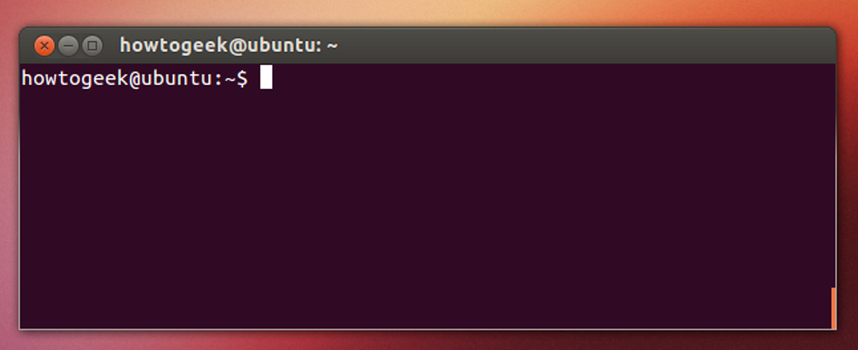


System Requirements
Linux ( Terminal )
Python 3.7+
Google Colab
Bed Tools (2bit2fa)
DeepLift
DeepBind etc.
Notes:
Explan the metrics - how you are going to apply it to the system
Afte this - UML diagram

Slide 8
USE CASE DIAGRAMS

Slide 9
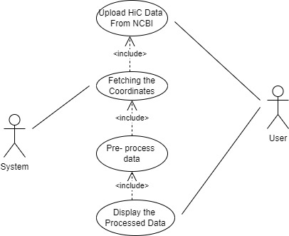
Fasta file generation - use case 1
Name | Generate Fasta File
Description | A Fasta file is generated from the HiC Data From NCBI
Pre condition | The dataset should not be empty
Sequence | User upload HiC data from NCBI System fetching the coordinates The data is pre processed into a Fasta File Format The resulting file is displayed on the screen
Post Condition | The user can see the Fasta File that is to the classified.

Slide 10
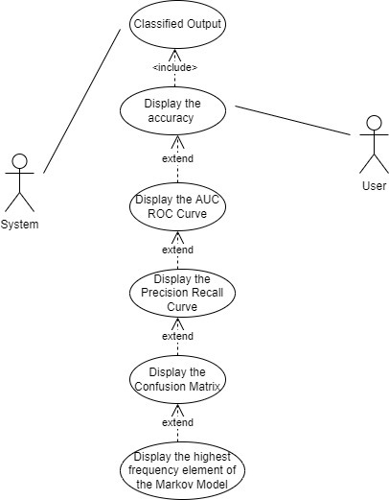
Data Visualisation - use case 2
Name | Generate Data Visualization
Description | Data visualizations are generated from the classifier output
Pre condition | The outputs should not be empty
Sequence | The classifier predicts the output The accuracy is displayed AUC ROC and Precision Recall Curves are shown Confusion Matrix can be seen The highest frequency element of the Markov Model is displayed
Post Condition | The user can see the data visualizations of the result generated

Slide 11
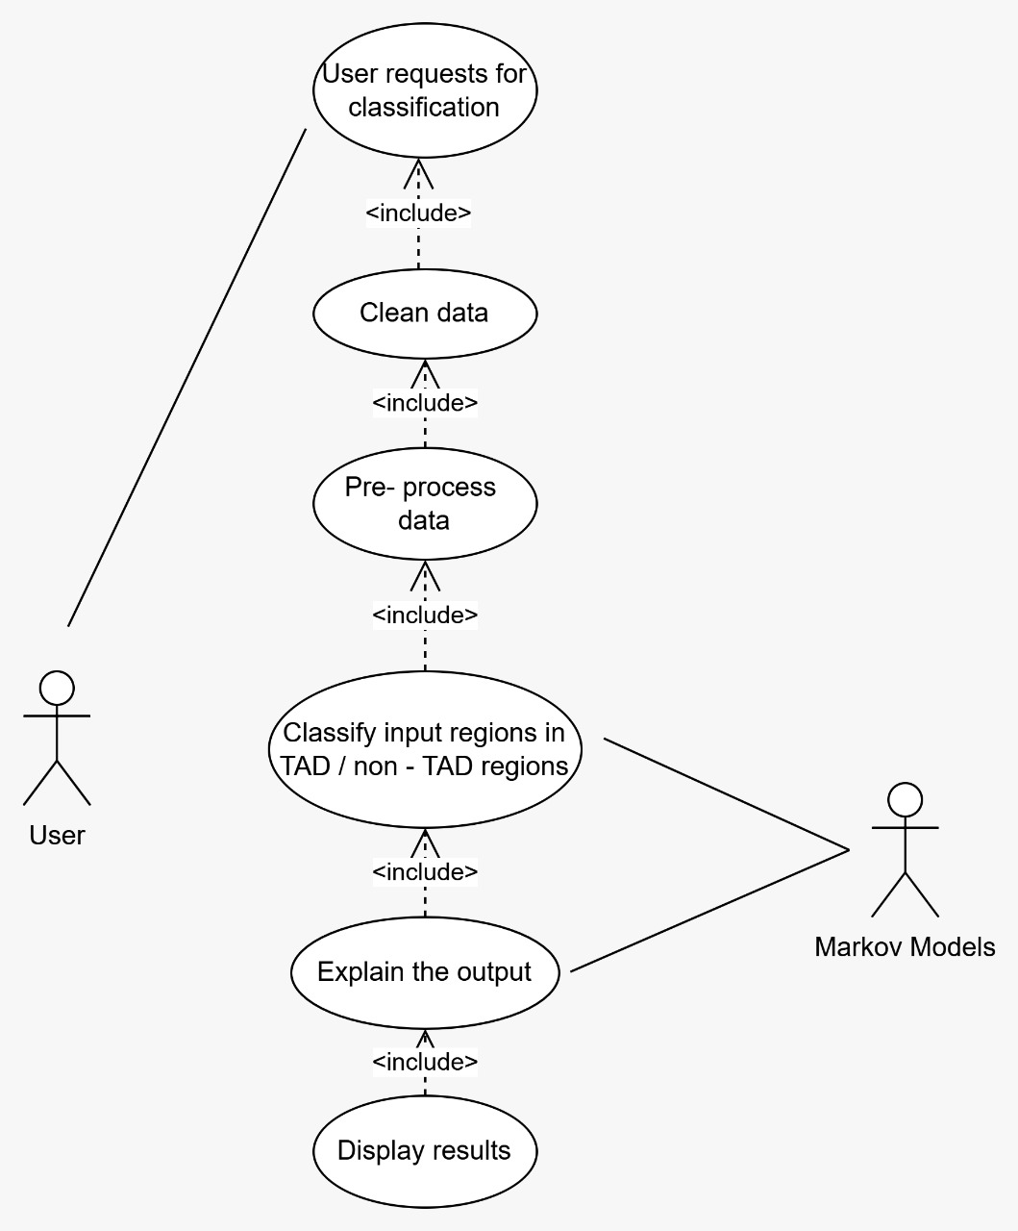
Complete system use case - Markov Models
Name | Predict using Markov Models
Description | The region is classified in TAD/Non TAD using Markov Models
Pre condition | The dataset should not be empty
Sequence | The dataset is cleaned and converted The inputs regions are classified The output is explained The results are displayed on the screen
Post Condition | The user knows the classification and the parameters which lead to the classification

Slide 12
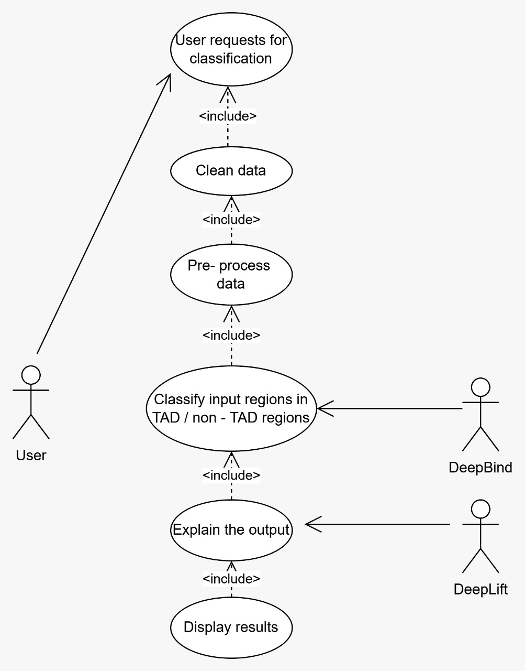
Complete System Use case - Deep Learning
Name | Predict using DeepBind and DeepLift
Description | The region is classified in TAD/Non TAD using DeepBind and the output is explained using DeepLift
Pre condition | The dataset should not be empty
Sequence | The dataset is cleaned and converted The inputs regions are classified The output is explained The results are displayed on the screen
Post Condition | The user knows the classification and the parameters which lead to the classification
Notes:
At last - a complete system use case

Slide 13
Data Flow Diagrams

Slide 14
DFD-0
INPUT
CLASSIFICATION
EXPLAINABLE AI
Model: Classification into TAD or non TAD
Understanding the classification output, explore WHAT caused the classification
Hi-C Experimental Data

Slide 15
DFD-1
Data Preprocessing
Classification
Explainable AI
- Input data: Hi-C experimental data (<1MB)
BED File (browser extensible data) with 20k regions of the human genome
- Convert data to a fasta format (text data ATGC)
- Bioinformatics pipelines
- Higher Order Markov Models
- Using data as an image data for Convolution Neural Networks: DeepBind
- Since deep learning models are hard to interpret: DeepLift for the Explainable AI to backtrack and answer “WHY”
Notes:
Flow of data on the arrows

Slide 16
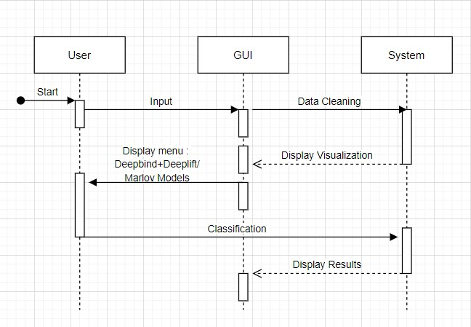
Sequence Diagram
Notes:
Givr the hyperlink

Slide 17
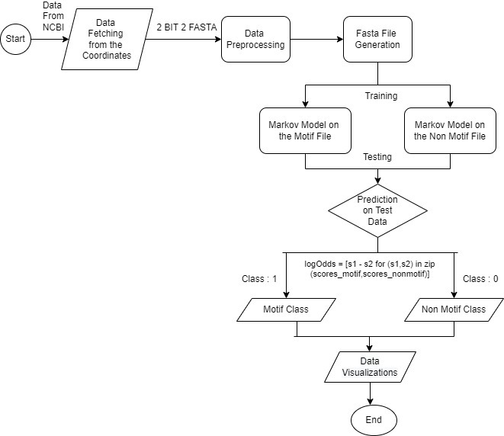
Activity Diagram
Notes:
Givr the hyperlink

Slide 18
Test Cases
Sr.no | Test Case Name | Purpose of the test | Input | Expected Output | Test Result
1 | Generate a Fasta File | To validate a Fasta file is generated from the HiC Data From NCBI | HiC Data From NCBI | The user can see the Fasta File that is to the classified. | Pass
2 | Predict using Markov Models | To validate the region is classified in TAD/Non TAD using Markov Models | Preprocessed Fasta File | The user can see the classification & the parameters which lead to the classification using Markov Models | Pass
3 | Predict using Deep Learning | To validate the region is classified in TAD/Non TAD using DeepBind and Deeplift | Preprocessed Fasta File | The user can see the classification & the parameters which lead to the classification using Deep Learning | Pass/Fail

Slide 19
Test Cases
Sr.no | Test Case Name | Purpose of the test | Input | Expected Output | Test Result
4 | Generate Data Visualizations | To validate that data visualizations are generated by the classifier output | Output from Classifier Data | The user can see data visualizations like the accuracy of the classifier, AUC RoC and Precision Recall Curves,Confusion Matrix, and the highest frequency element from the Markov Model | Pass

Slide 20



Environment and technologies used
Coding Language:
Python
Bash
Web IDE:
Google Colab
Hardware requirements:
GPU access for training models
Linux Kernel for bioinformatics tools (BED Tools)
Intel i3 or higher
4GB RAM
1 Gb hard free drive space
Notes:
verions

Slide 21


Standard Tools and Libraries used
Tools and Algorithms:
BED Tools
DeepLift
DeepBind
Python Libraries required:
Sklearn v0.24.1
Numpy v1.18
Pandas v1.2.0
Matplotlib v3.5.1
Seaborn v0.11
Notes:
Versions

Slide 22
Implementation
Markov models on Dummy Data and motifs
Markov models on Dummy Data and JASPAR Motifs
Markov Models with Cross Validation
Implementation PPT Link

Slide 23
Markov models on Dummy data

Slide 24
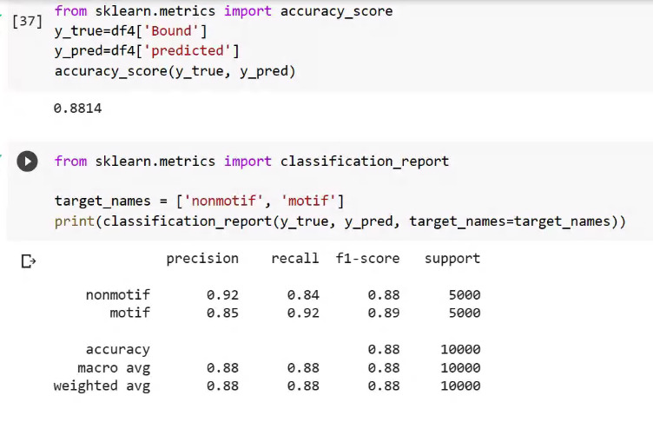
10k sequences, 3 degree MM
Notes:
Accuracy score = Tp + tn / sum of all
Precision = tp / tp + fp
Recall = tp / tp + fn
F1 = 2 * ( precision x recall / precision + recall)
Pseudo count

Slide 25
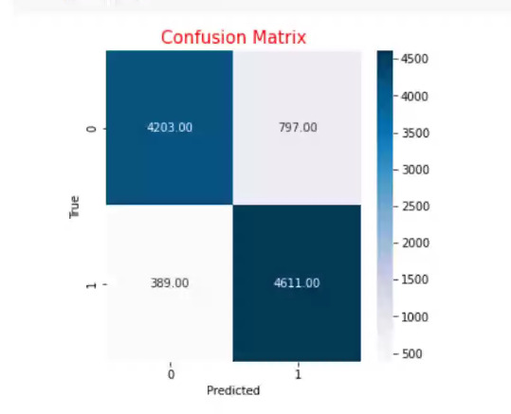
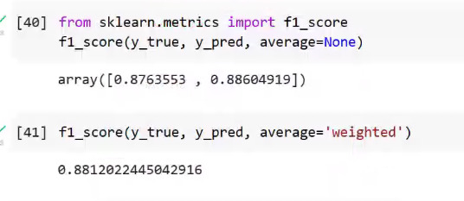
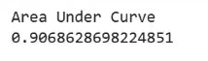
TP
FP
FN
TN

Slide 26
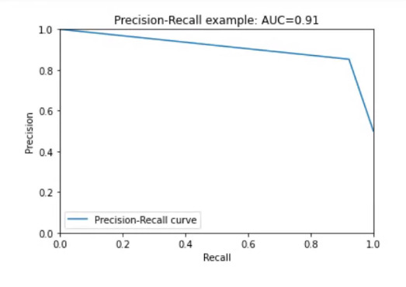
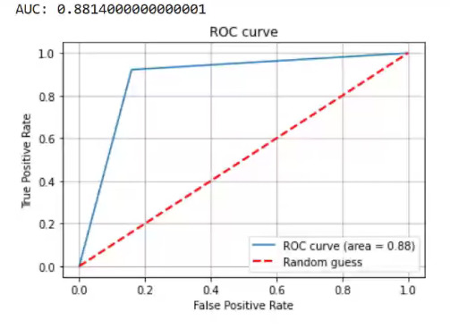
Notes:
A precision-recall curve shows the relationship between precision (= positive predictive value) and recall (= sensitivity) for every possible cut-off. The PRC is a graph with:
• The x-axis showing recall (= sensitivity = TP / (TP + FN))
• The y-axis showing precision (= positive predictive value = TP / (TP + FP))
AUC
Y_pred: the score -
Score: sort:

Slide 27
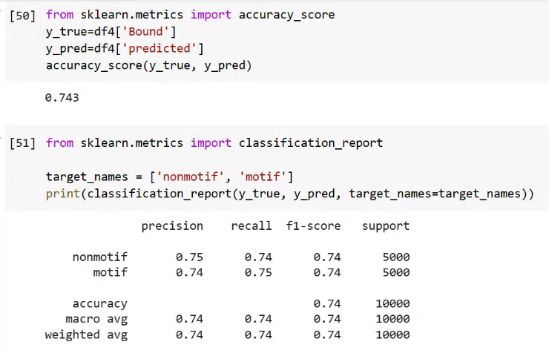
10k sequences, 2 degree markov model

Slide 28
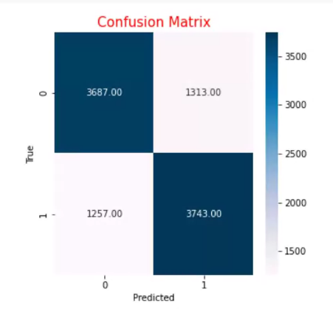
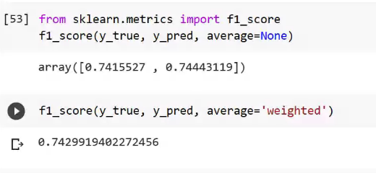
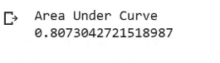

Slide 29
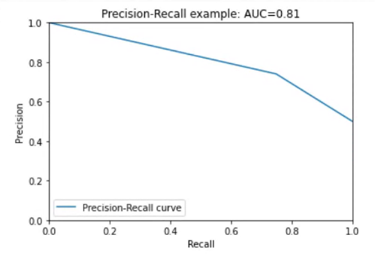
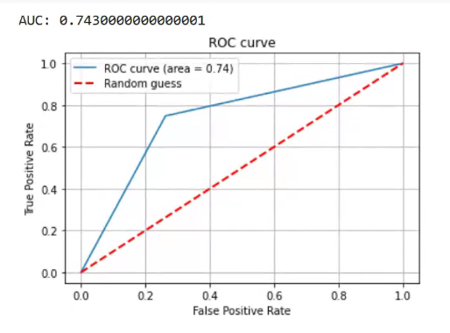

Slide 30
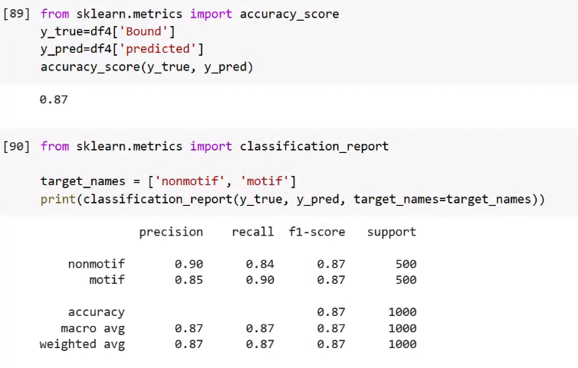
1k sequences, 3 degree markov model

Slide 31
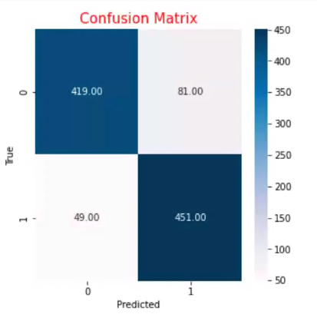
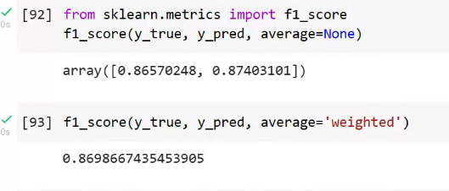
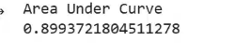

Slide 32
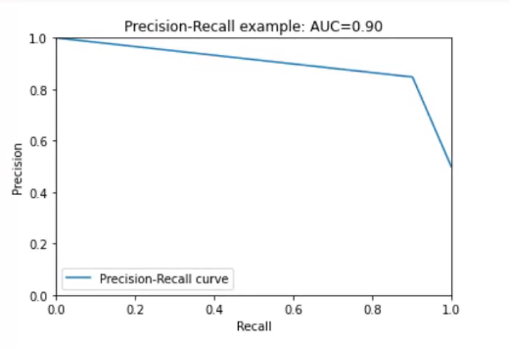
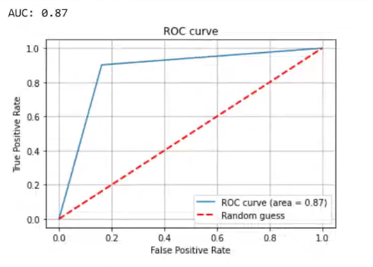

Slide 33
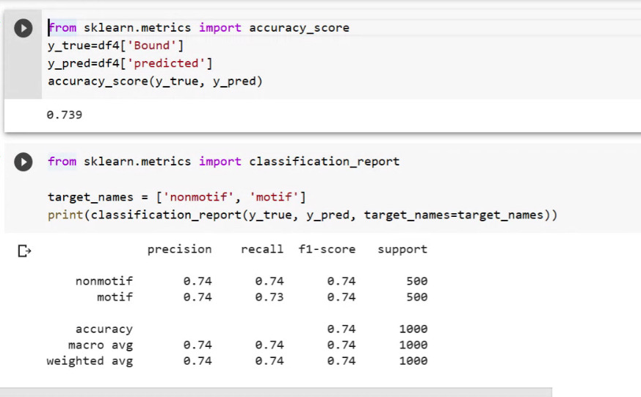
1k sequences, 2 degree MM

Slide 34
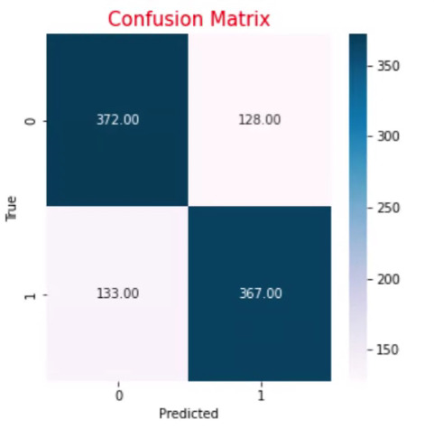
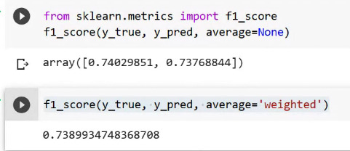

Slide 35
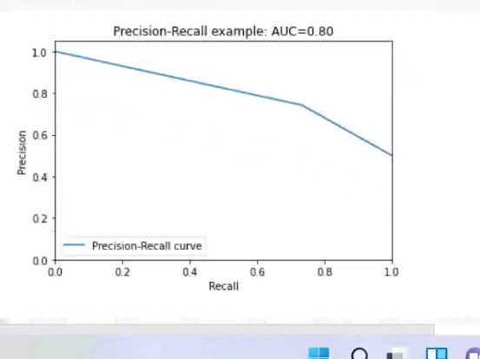
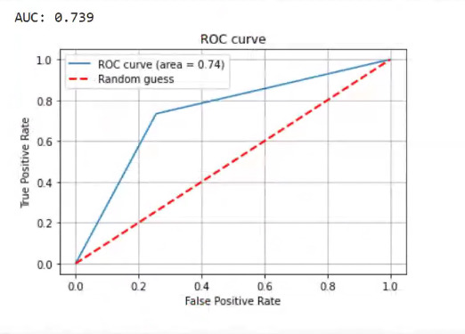

Slide 36
Markov models on Dummy data with Jaspar Motifs

Slide 37
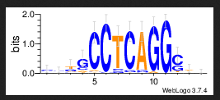
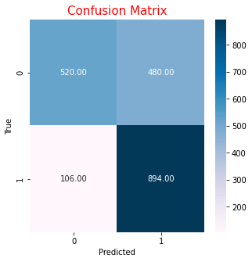
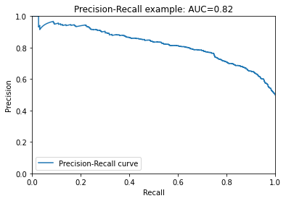
MA0003.4. - JASPAR
FoldID EventID start_index ... Bound predicted log odd score
0 A seq_986_peak -5 ... 0 0 -36.508978
1 A seq_902_peak -5 ... 0 0 -5.136077
2 A seq_963_peak 267 ... 1 1 66.917289
3 A seq_361_peak -5 ... 0 1 17.650922
4 A seq_487_peak -5 ... 0 0 -5.649734
... ... ... ... ... ... ... ...
1995 A seq_309_peak -5 ... 0 0 -5.455076
1996 A seq_960_peak -5 ... 0 0 -19.066406
1997 A seq_196_peak 49 ... 1 0 -3.408055
1998 A seq_756_peak 103 ... 1 1 14.057043
1999 A seq_86_peak -5 ... 0 0 -5.472158
Area Under Curve - 0.82
Accuracy - 0.71
Highest Accuracy for 12th Order Model

Slide 38
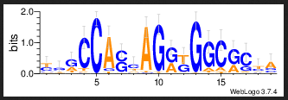

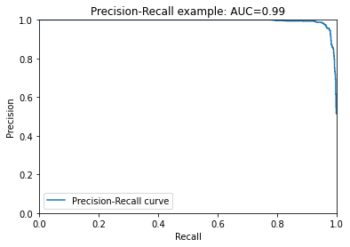
MA0139.1 - JASPAR
Step: 13
FoldID EventID start_index ... Bound predicted log odd score
0 A seq_392_peak 65 ... 1 1 28.419112
1 A seq_310_peak -5 ... 0 0 -6.635404
2 A seq_779_peak -5 ... 0 0 -4.868262
3 A seq_468_peak -5 ... 0 1 10.800039
4 A seq_648_peak 38 ... 1 1 33.041807
... ... ... ... ... ... ... ...
1995 A seq_627_peak -5 ... 0 0 -14.199399
1996 A seq_82_peak -5 ... 0 0 -8.730004
1997 A seq_990_peak 73 ... 1 1 27.079548
1998 A seq_29_peak 93 ... 1 1 10.662202
1999 A seq_840_peak -5 ... 0 1 10.074845
[2000 rows x 7 columns]
0.756
Area Under Curve - 0.99
Accuracy - 0.756
Highest Accuracy for 13th Order Model

Slide 39
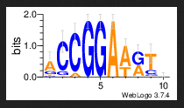
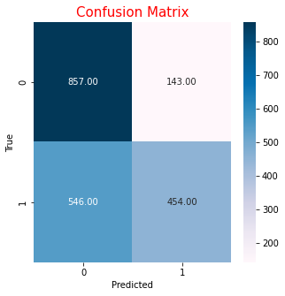
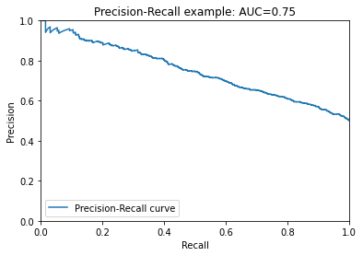
MA0098.3 - JASPAR
FoldID EventID start_index ... Bound predicted log odd score
0 A seq_929_peak 233 ... 1 0 -8.924894
1 A seq_888_peak -5 ... 0 0 -5.275024
2 A seq_234_peak 173 ... 1 1 7.202054
3 A seq_703_peak -5 ... 0 0 -2.284430
4 A seq_47_peak -5 ... 0 0 -12.688222
... ... ... ... ... ... ... ...
1995 A seq_472_peak -5 ... 0 0 -7.479195
1996 A seq_488_peak 176 ... 1 0 -1.751096
1997 A seq_356_peak 19 ... 1 0 -7.403903
1998 A seq_224_peak 263 ... 1 0 -2.236263
1999 A seq_417_peak 133 ... 1 0 -21.421124
Area Under Curve - 0.75
Accuracy - 0.66
Highest Accuracy for 5th Order Model

Slide 40
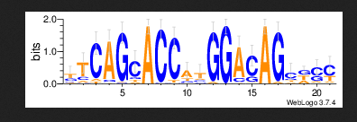
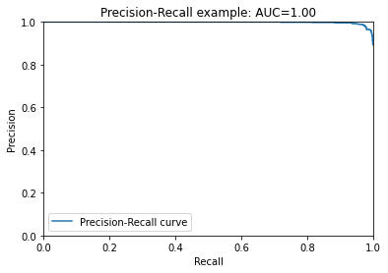
MA0138.2 - JASPAR
Step: 12
FoldID EventID start_index ... Bound predicted log odd score
0 A seq_502_peak 137 ... 1 1 65.471255
1 A seq_742_peak 171 ... 1 1 73.240184
2 A seq_183_peak -5 ... 0 0 -22.442878
3 A seq_548_peak 196 ... 1 1 74.294207
4 A seq_941_peak 71 ... 1 1 84.484397
... ... ... ... ... ... ... ...
1995 A seq_852_peak -5 ... 0 1 8.025897
1996 A seq_160_peak 238 ... 1 1 52.876794
1997 A seq_446_peak 86 ... 1 1 51.588498
1998 A seq_928_peak -5 ... 0 0 -4.314711
1999 A seq_118_peak 137 ... 1 1 46.451450
0.747
Area Under Curve - 1.00
Accuracy - 0.747
Highest Accuracy for 12th Order Model

Slide 41
Markov models with Cross Validation

Slide 42
Data Preparation
PFM
- PWM is created using the PFM from Jaspar
- From the PWM we create the motifs
- The background data is 0.25 ACGT
- Generated motifs from the PPM to append to background sequences
- Generated 1 motif file embedding the motif in it and 1 non motif file
Non Motif File Length: 314
Motif File Length : 300
Length of Motif:14
PWM
Motifs
Data Preparation
Motif File
Non motif file
Notes:
Data set

Slide 43
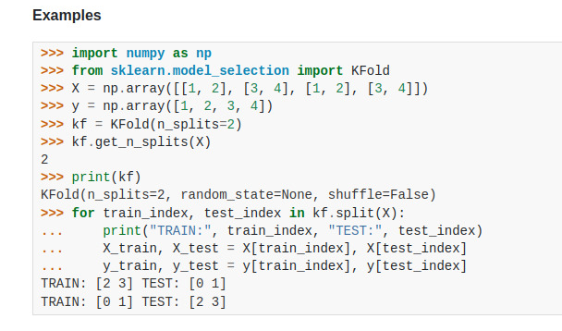
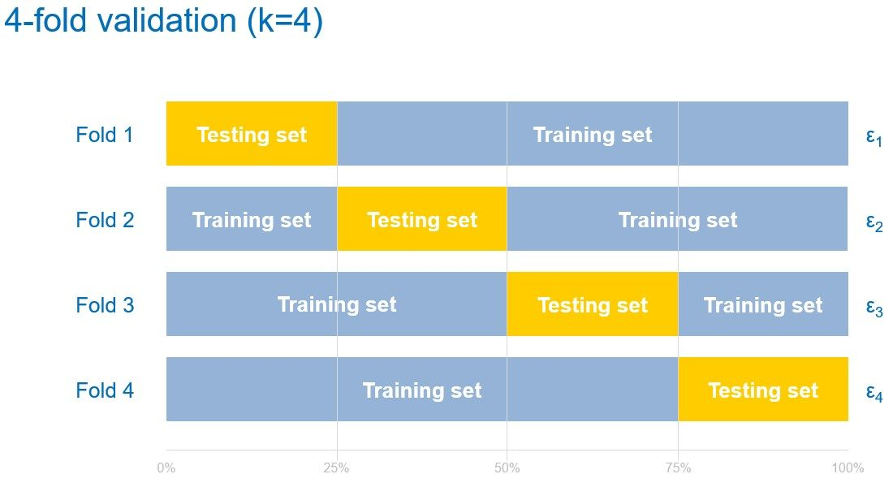
Cross Validation
Took the 2 datasets - motif and non-motif and got the splits.
Size of splits=10
At every iteration, we took the train data from the split of both datasets and made 2 Markov models
Combined the test data from each split of both datasets
sklearn.model_selection.KFold

Slide 44
Flow Diagram
Start
For num of the k folds
Training
Markov Model on Motif
Markov Model on Non Motif
Combined Testing
Predicting the class using the log odd score
logOdds = [s1 - s2 for (s1,s2) in zip (scores_motif,scores_nonmotif)]
Motif Class
Non Motif Class

Slide 45
Log Odds Score
Odds is defined as probability of success/probability of failure
Log odds is the logarithm of the odds
Use log odds because they’re so easily updated with new data.

Slide 46
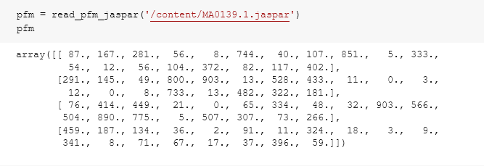
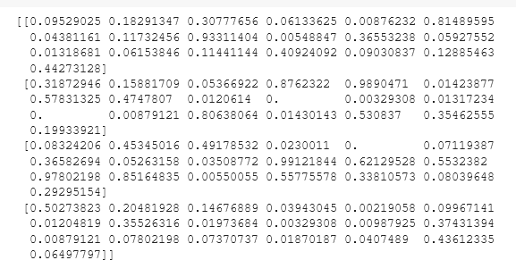
(PPT Link : Slides)

Slide 47
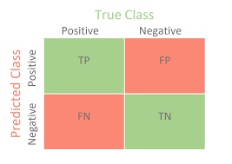
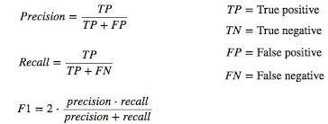
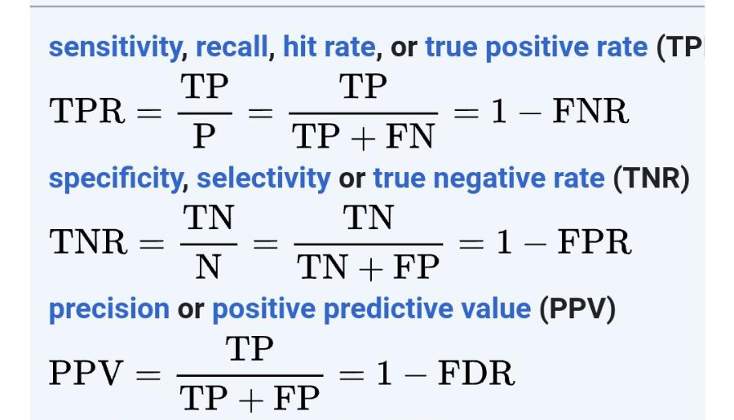
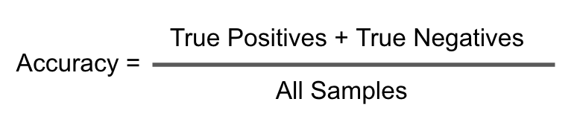
Metrics for Classification
Accuracy: sklearn.metrics.accuracy_score
Confusion Matrix: sklearn.metrics.confusion_matrix
AUC ROC: sklearn.metrics.roc_auc_score
F1 score: sklearn.metrics.f1_score

Slide 48
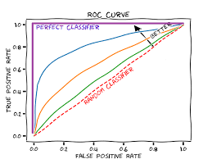
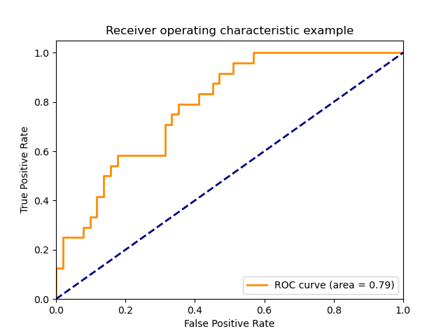
ROC AUC CURVES
- ROC = Receiver Operating Characteristic
- Plot of the false positive rate (x-axis) versus the true positive rate (y-axis)
- Used when there are roughly equal numbers of observations for each class.
- The Area Under the Curve (AUC) is the measure of the ability of a classifier to distinguish between classes and is used as a summary of the ROC curve. The higher the AUC, the better the performance of the model at distinguishing between the positive and negative classes.
- how to choose a threshold? choose the threshold that maximizes TPR−FPR.

Slide 49
Random seed
Used to initialize the random number generator for reproducibility purpose to ensure we get a similar sequence of random numbers each time we run the algorithm
random.seed(a=None, version=2)

Slide 50

Results

Slide 51

Results

Slide 52




Curves for the first fold :
k=2 | k=3 | k=4
k=5

Slide 53
Current Challenges
Overfitting, for MM order >6, the AUC = 1
Time complexity: n**2
Initialising new dictionaries for every fold of the cross validation

Slide 54
Thank you

